Slide 1


Phase 2 Presentation
Big data engineering project on azure
Kha pham

Slide 2
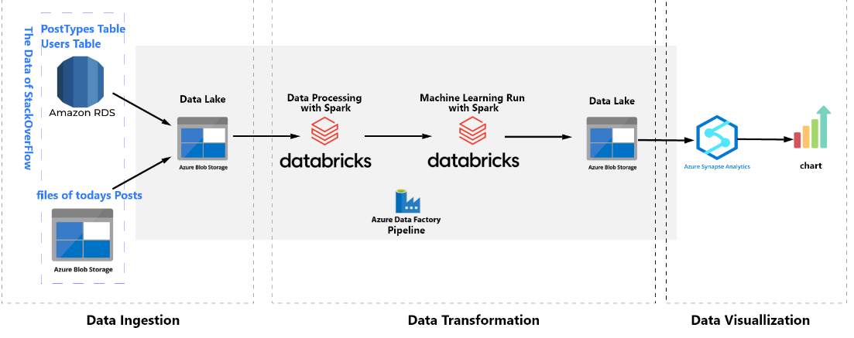
Project Overview

Slide 3
Stage 1: Data Ingestion
Created separate resource group for the project so that we can delete the resource group after completing the project to avoid being further charged.
Created a storage account, a container, and folders to accept the files from the data sources. It’s noted to create a data lake instead of a simple blob storage by ticking on the Enable hierarchical namespace. The folder postTypes accept the table postTypes on PostgreSQL; The folder Users accepts the table Users on PostgreSQL; The folder Posts accepts today's Parquet files. In addition, we need to empty the folders prior to copy the data in these folders.
Created 3 linked services:
Linked Service 1: link the RDS PostgreSQL database
Linked Service 2: link WeCloudData's public storage blob
Linked Service 3: link my storage blob
Created 6 datasets:
2 source dataset - from postType and User
2 sink dataset represent the sink at my blob storage
1 source dataset - from wecloud public storage
1 sink dataset connected to the Posts folder on my blob storage.

Slide 4
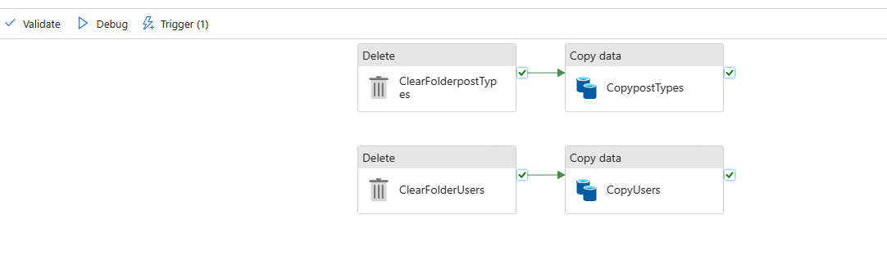
Stage 1: Data Ingestion
Created a Data Factory Resource with 2 pipelines: copyOnceWeek and copyPostsEveryday
pipeline 1: copyOnceWeek. The trigger is set to run the pipeline once per week.

Slide 5
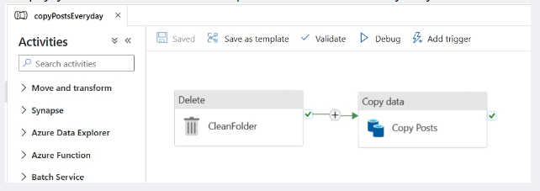
Stage 1: Data Ingestion
pipeline 2: : copyPostsEveryday. The trigger is set to run the pipeline daily.

Slide 6
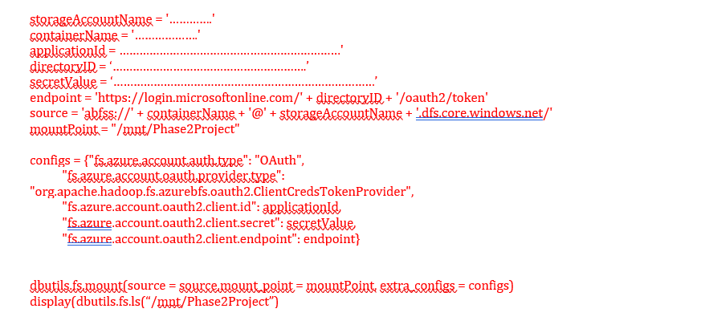
Stage 2 – Data Transformation
Step 1: mount Azure storage to Azure Databricks
Create Databricks workspace, then compute, and notebook
In Azure, allow the Azure Databricks to access the storage container.

Slide 7
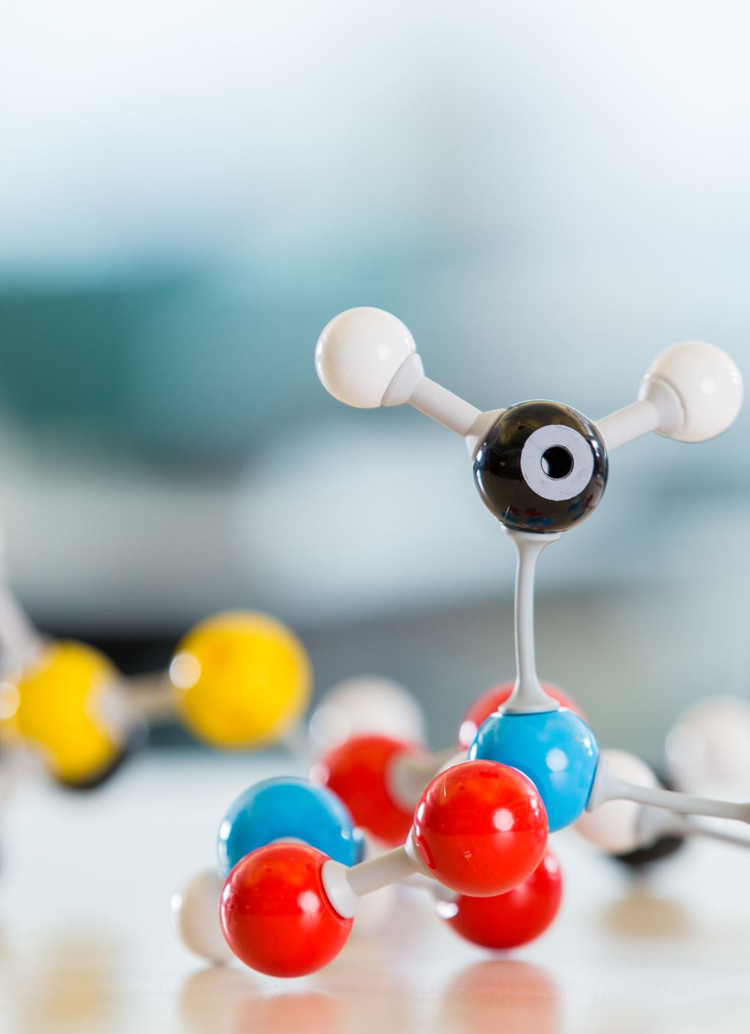
Stage 2 – Data Transformation
Step 2: to train a machine learning model. The model will use data copied from the everydayCopy Posts pipeline and copyonceWeek pipeline to tell us what each post is about (the topic of the post).
Joined the Posts and posttypes tables, because we need to use the Type column in the posttypes table to filter out the posts in Posts table we want.
Cleaned data for the model training;
Trained the machine learning model;
Saved the model to an Azure storage folder so that we can use it in Step 3.

Slide 8
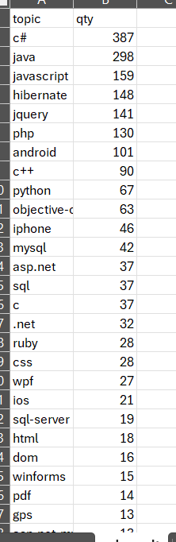
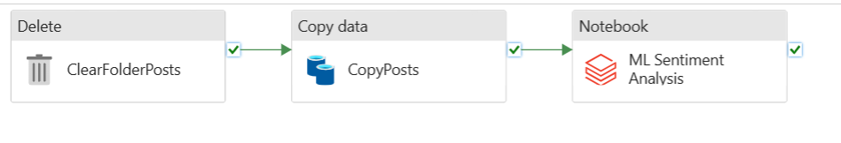
Stage 2 – Data Transformation
Step 3: sentiment analysis

Slide 9
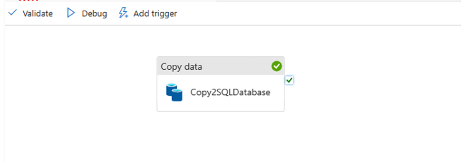
Stage 3 – Data Visualization
Copied result to Azure SQL Database, and then connect this data base to Power BI Desktop for data visualization.
I created pipeline #3 to copy data from the blob storage to Azure SQL Database.
Prior to doing so, I created a table in Azure SQL Database:
CREATE TABLE ML_result (topic VARCHAR(MAX), qty INT);
In the copy activity, to set
First row as header
Truncate the table in Azure SQL Database

Slide 10
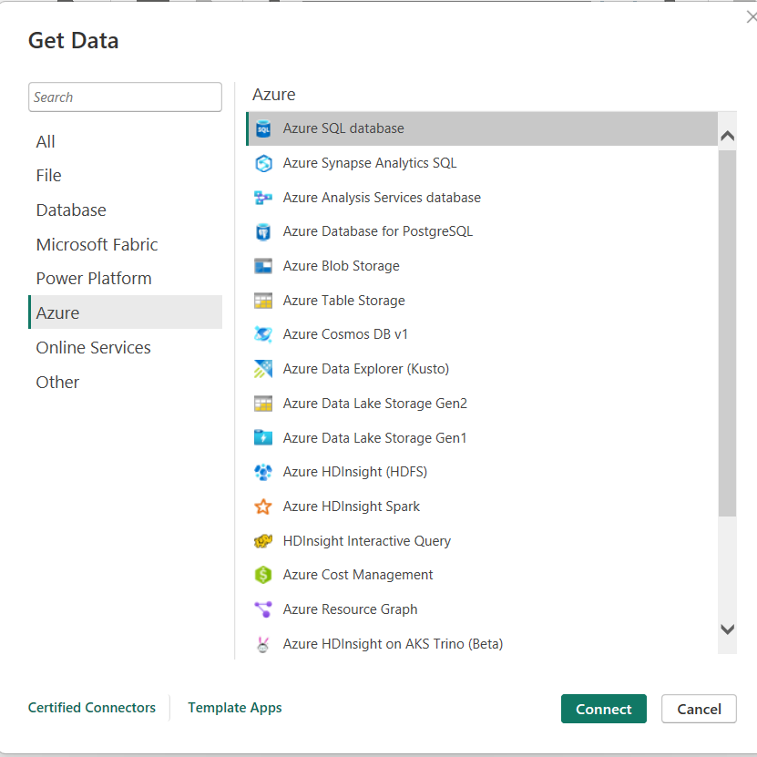
Stage 3 – Data Visualization
Connect Power BI to Azure SQL Database

Slide 11
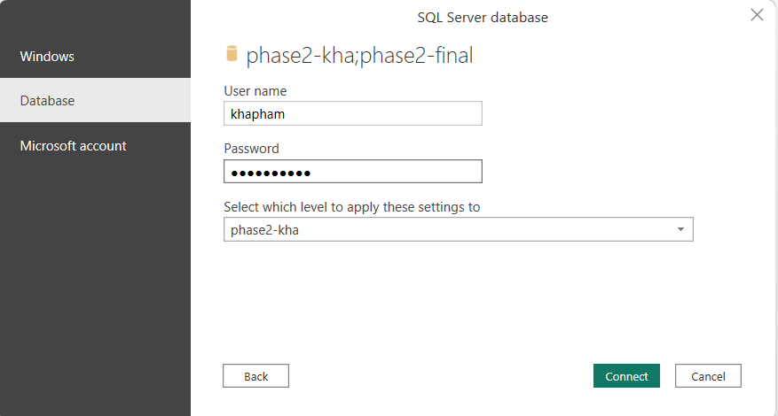
Stage 3 – Data Visualization
In the server name, please make sure to add server name, and the string in red as follows: .database.windows.net

Slide 12
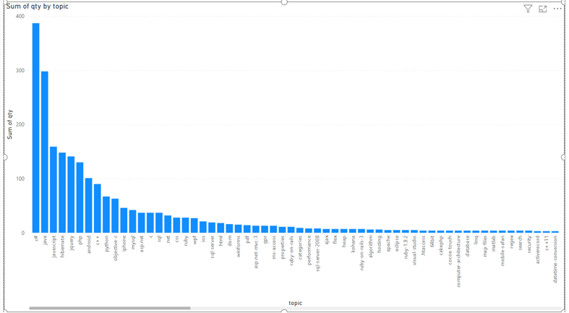
Stage 3 – Data Visualization

Slide 13
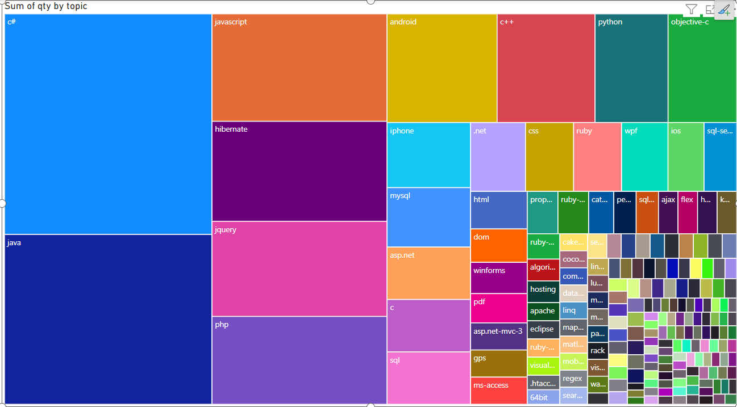
Stage 3 – Data Visualization

Slide 14
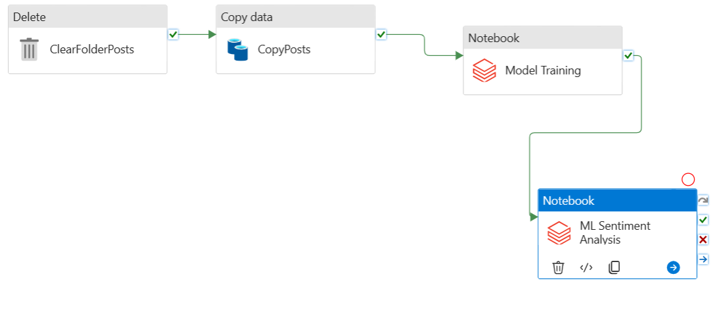
Problems
Lazy Execution of Databricks
Connecting Power Bi to Azure SQL Database: In the server name, please make sure to add server name, and the string in red as follows: .database.windows.net

Slide 15

If I had more time
Complete the option 2 for deployment of CI/CD for the project using Azure Dev Ops.
Automated publishing for continuous integration and delivery - Azure Data Factory | Microsoft Learn

Slide 16
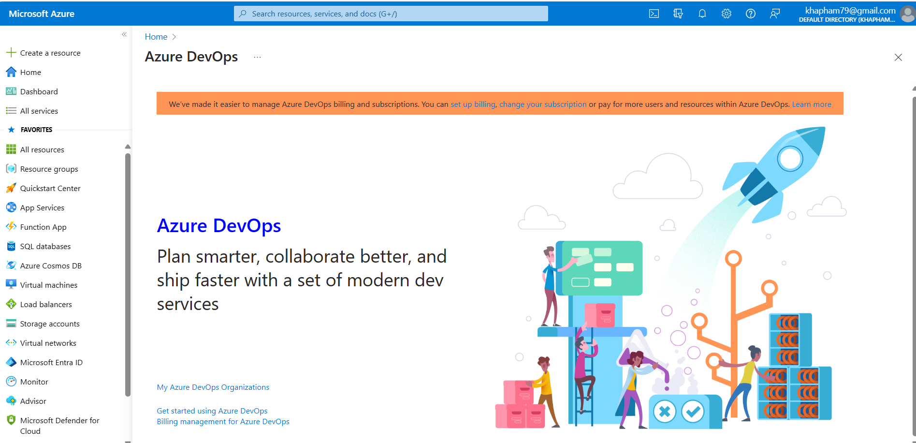
CI/CD with Azure Dev Ops

Slide 17
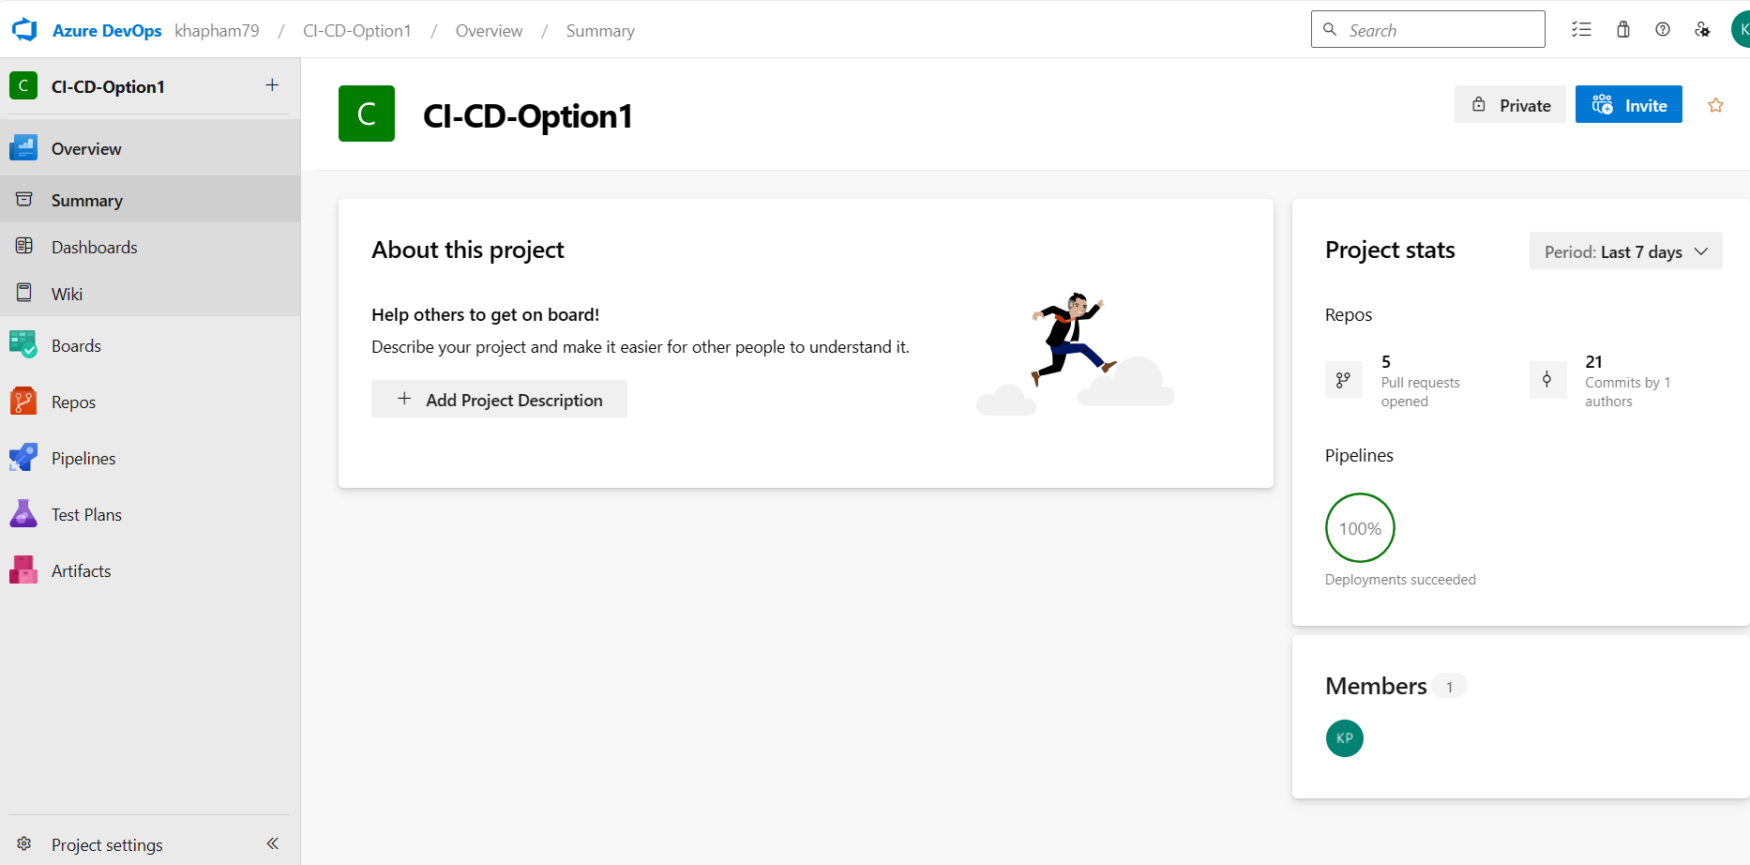
CI/CD with Azure Dev Ops

Slide 18
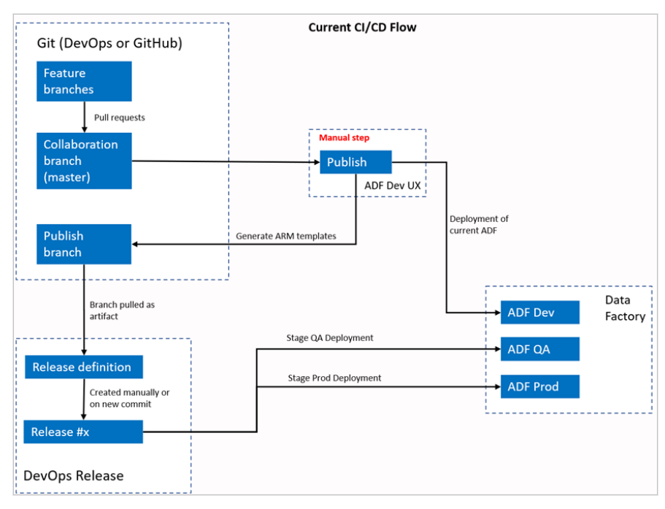
CI/CD Flow Option 1

Slide 19
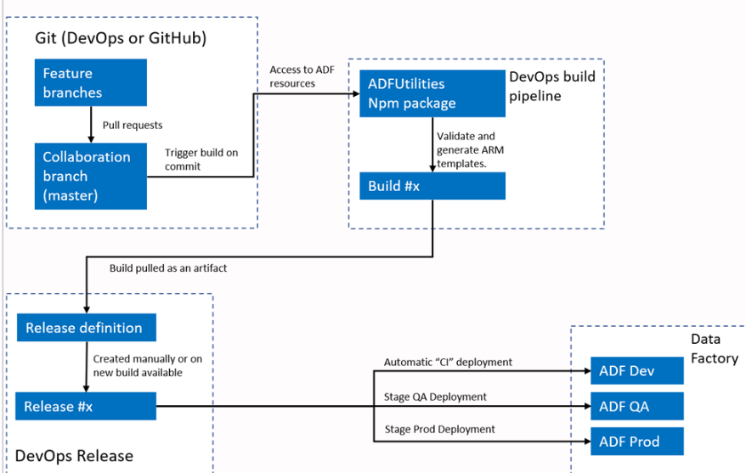
CI/CD Flow Option 2

Slide 20

CI/CD Set up Step 1
As we need Hosted Parallelism to run pipeline in step 2, this can be requested for free by filling out the form at below link, then submit, and await for approval. Usually, it takes 2-3 working days to obtain the approval.
https://aka.ms/azpipelines-parallelism-request.

Slide 21
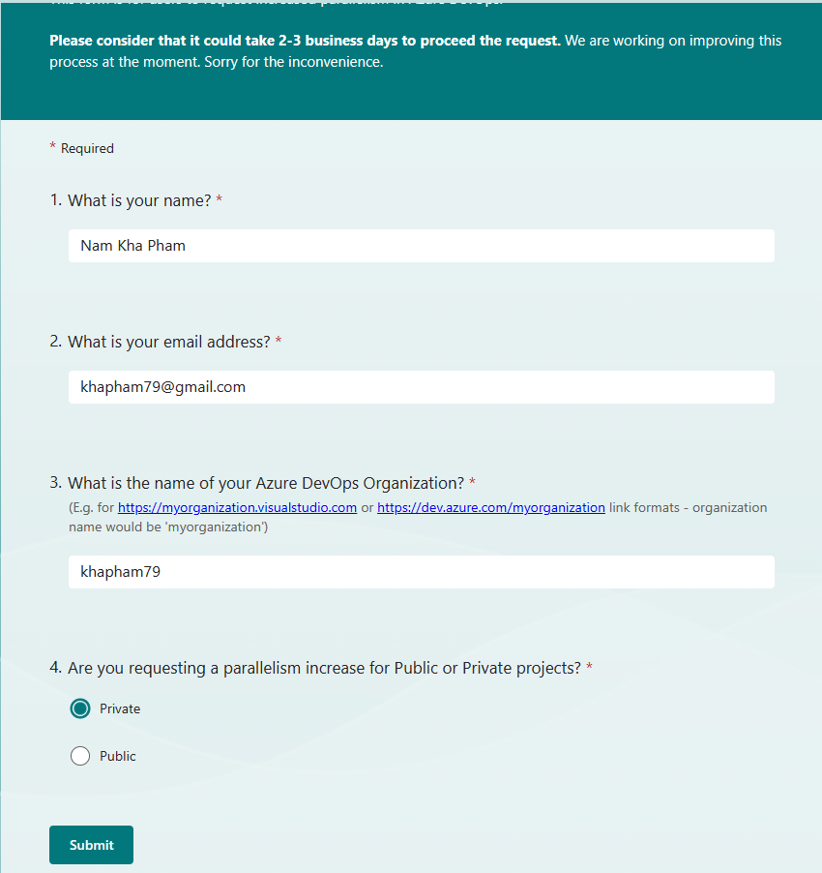
CI/CD Set up Step 1

Slide 22
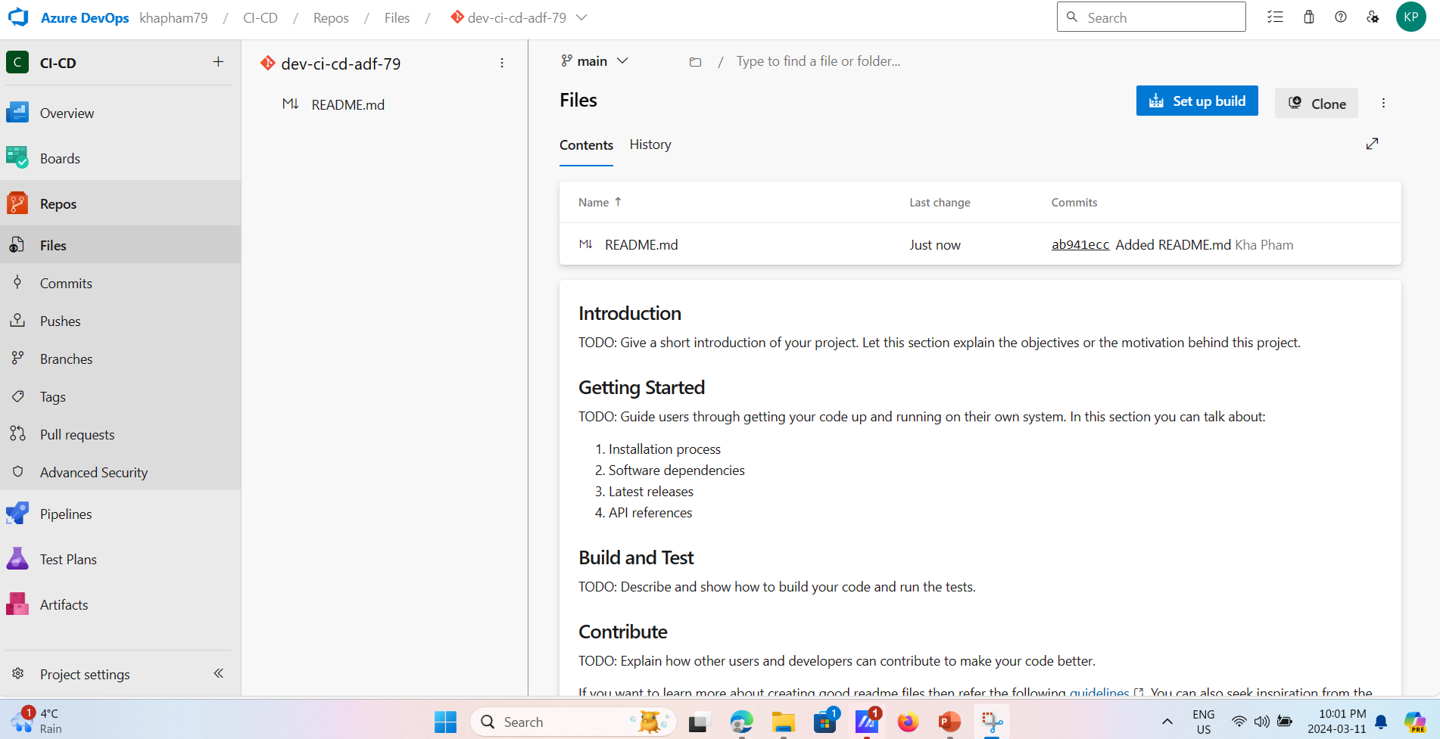
CI/CD Set up Step 2 – Git Configuration
Create Git depository using Dev Ops portal:

Slide 23
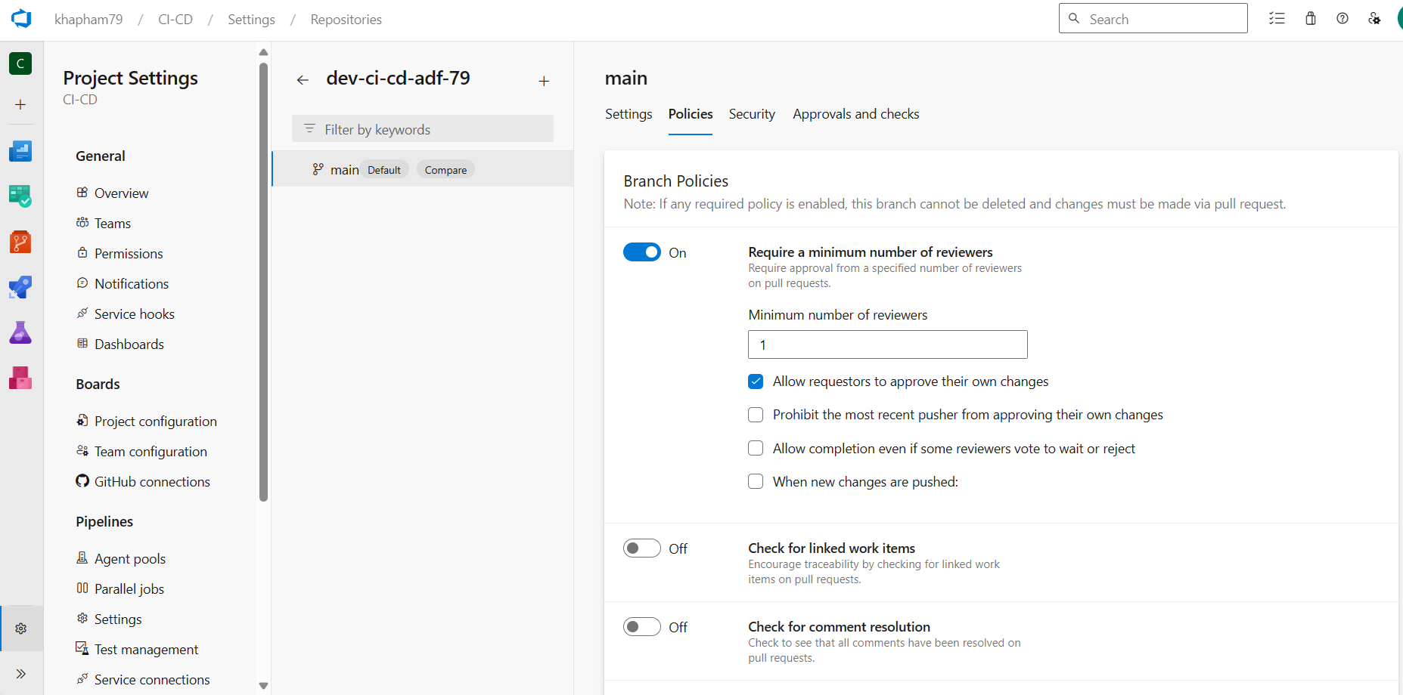
CI/CD Set up Step 2
Create Branch Policy:

Slide 24
CI/CD Set up Step 3
Create 2 resource group with 2 data factory for each on Azure portal:
Development (dev)
Production (prod)

Slide 25
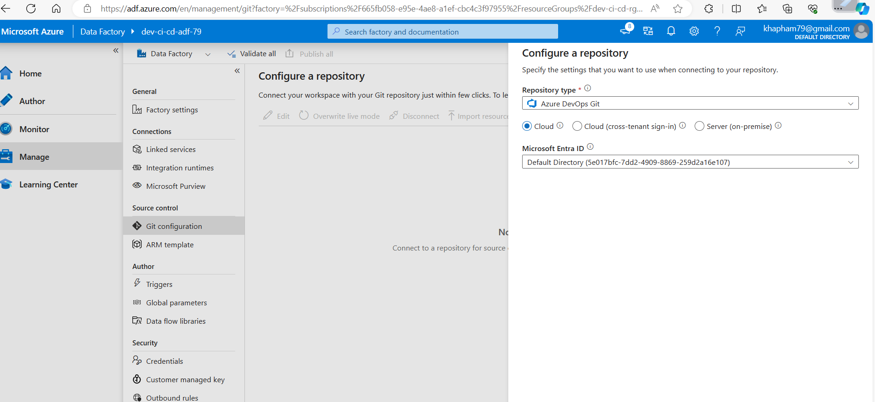
CI/CD Set up Step 4
Configure repository on Development Data Factory:

Slide 26
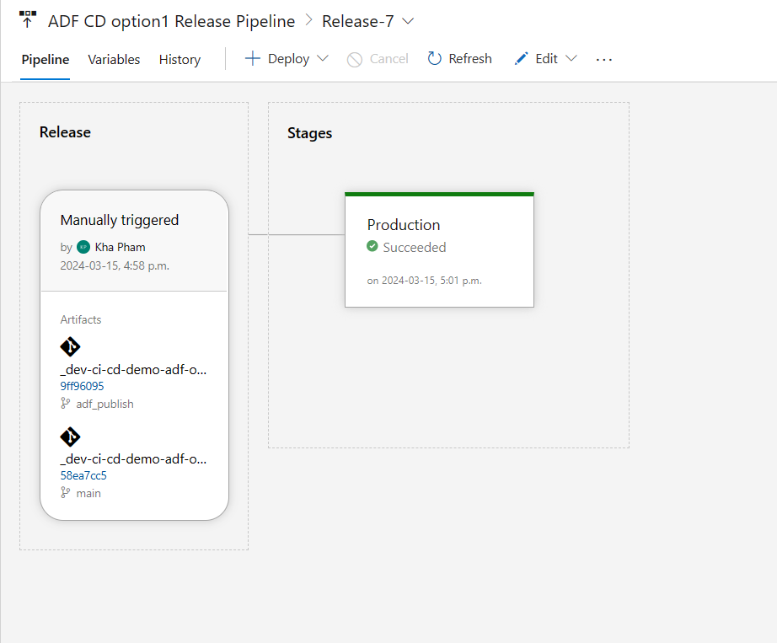
CI – CD Option 1

Slide 27





Thank you!

